Slide 1
Speech Recognition Final Project Resources
Professor: Dr. Veton Kepuska
Class: ECE5526 Speech Recognition
Student: Chih-Ti Shih

Slide 2
FTP Server Information
Host: 163.118.203.219
User ID: student
Password: student
Port:21

Slide 3
Callhome English Speech Corpus
The Callhome English Speech Corpus, produced by the Linguistic Data Consortium.
The CALLHOME English corpus of telephone speech consists of 120 unscripted telephone conversations between native speakers of English.

Slide 4
Callhome English Speech Corpus - directory
callhome/doc: directory of documentation for Callhome English speech.
callhome/english: path to the speech data files, divided into train, devtest and evltest.
0README.1st : Corpus information file.

Slide 5
TIMIT Acoustic-Phonetic Continuous Speech Corpus
The TIMIT corpus of read speech has been designed to provide speech data for the acquisition of acoustic-phonetic knowledge and for the development and evaluation of automatic speech recognition systems.
TIMIT contains a total of 6300 sentences, 10 sentences spoken by each of 630 speakers from 8 major dialect regions of the United States.

Slide 6
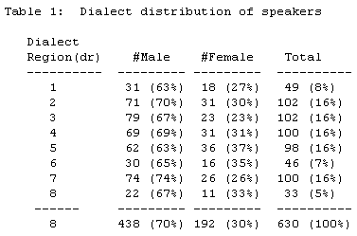
TIMIT Acoustic-Phonetic Continuous Speech Corpus

Slide 7
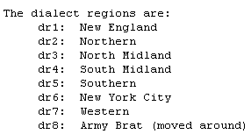
TIMIT Acoustic-Phonetic Continuous Speech Corpus

Slide 8
FFM TIMIT
The FFMTIMIT corpus contains the previously unreleased secondary microphone recordings of the TIMIT corpus.
FFMTIMIT contains a total of 6130 sentences, 10 sentences spoken by each of 613 speakers from 8 major dialect regions of the United States.

Slide 9
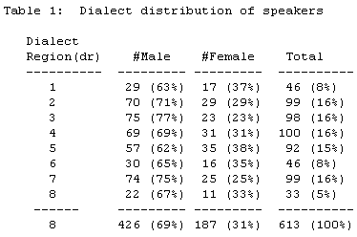
FFM TIMIT – speaker information

Slide 10
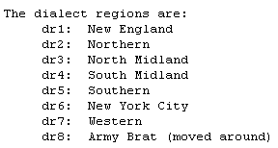
FFM TIMIT – dialect information

Slide 11
FFM TIMIT - directory
FFM Timit/sphere/ : directory containing the NIST Speech Header Resources (SPHERE) software; SPHERE is a set of "C" library routines and programs for manipulating the NIST header structure prepared to the FFMTIMIT waveform files.
FFM Timit/ffmtimit/ : directory containing the FFMTIMIT corpus as well as FFMTIMIT related documentation.

Slide 12
MOCHA - TIMIT
The MOCHA TIMIT corpus includes 3 sets of 460 short sentences designed to include the main connected speech processes in English.
The corpus includes Acoustic Speech Waveform, Laryngograph Waveform, Electromagnetic Articulograph and Electropalatograph Frames.

Slide 13
MOCHA TIMIT – File Formate
Total of 3 sample sets: fsew0_v1.1.tar, maps0.tar and msak0_v1.1.tar.
Each of them includes:
*.wav file, Acoustic Speech Waveform.
*.lar file, Laryngograph Waveform.
*.ema file, Electromagnetic Articulograph.
*.epg file, Electropalatograph Frames.
*.lab file, Label *.lab

Slide 14
NYNEX PhoneBook
PhoneBook is a phonetically-rich, isolated-word, telephone-speech database, created because of :
The lack of available large-vocabulary isolated-word data.
Anticipated continued importance of isolated-word and keyword-spotting technology to speech-recognition-based applications over the telephone.
Findings that continuous-speech training data is inferior to isolated-word training for isolated-word recognition.

Slide 15
NYNEX PhoneBook - information
The core section of PhoneBook consists of a total of 93,667 isolated-word utterances, totalling 23 hours of speech. This breaks down to 7,979 distinct words, each said by an average of 11.7 talkers, with 1,358 talkers each saying up to 75 words. All data were collected in 8-bit mu-law digital form directly from a T1 telephone line. Talkers were adult native speakers of American English chosen to be demographically representative of the U.S.

Slide 16
NYNEX PhoneBook – directory & files
The disc 1 and 2 include the read isolated word set. The disc 3 includes spontaneous utterance set.
fnl_rprt.doc: documentation describing corpus collection.
wav_file.lst: list of file name paths to all speech files on this disc.
sphere/ : NIST SPHERE software package (source code).
read_sp/ : isolated word speech files (discs 1 and 2)
spon_sp/ : spontaneous phrase speech files (disc 3)
wordlist/ : complete set of data tables relating words,

Slide 17
ICSI Meeting Recorder Digits Corpus
ICSI (International Computer Science Institute) Meeting Recorder Digits Corpus non-segmented recordings of read connected digits.
ICSI Meeting Recorder Digits Corpus includes 2790 digit utterance.
Directory: ICSI_Meeting_Recorder_Digits_Corpus/
ICSI Project site: Link

Slide 18
CCW17 Corpus (WUW Corpus)
Directory: CCW17/
Subdirectory and files:
Calls/ : Isolated words utterances recorded in 8-bit ulaw format.
Ccw17.trans : file IDs include utterances location and transcriptions.

Slide 19
WUW_Corpus
WUW corpus is a corpus used in WUW project by Dr. Kepuska.
Directory: WUW_Corpus
Subdirectory and files:
Calls/ : Isolated words utterances recorded in 8-bit ulaw format.
WUW.trans :utterances information and location.

Slide 20
WUWII_Corpus
WUW 2 corpus is a corpus used in WUW project by Dr. Kepuska.
Directory: WUWII_Corpus/
Subdirectory and files:
Calls/ : Isolated words utterances recorded in 8-bit ulaw format.
WUWII.trans :utterances information and location.

Slide 21
Speech Tools: Praat
Praat: program for speech analysis and synthesis.
Introduction presentation done by current student, Dileep. Link
Official site: Link
Praat Lab: Link

Slide 22
Speech Tool: CMU Sphinx
The CMU Sphinx consists the following elements:
Decoder: Sphinx2, Sphinx3, Sphinx4 and PocketSphinx.
Acoustic Model Training tool: Sphinx Train.
Language Model Training tool: cmuclmtk (The CMU-Cambridge Statistical Language Modeling Toolkit) and SimpleLM.

Slide 23
Speech Tool: CMU Sphinx - resource
Audio data: MicArray, AN4, Let’s go, CMU-SIN, PDA and RM1.
Open Source Models:
Communicator acoustic models, dialog system.
WSJ1 acoustic models, dictation.
WSJ1 acoustic models, dictation.
HUB4 acoustic models, broadcast news.
Dictionary: The CMU Pronouncing Dictionary

Slide 24
Speech Tools: BootCat LM toolkit
BootCaT: Bootstrapping Corpora and Terms from the Web.
Simple Utilities for Bootstrapping Corpora and Terms from the Web.
Directory: Tool/BootCat/
Using BootCat to create LM from WWW. Link

Slide 25
Speech Tools: VoiceBox
VoiceBox is a speech processing toolbox consists of MATLAB routines.
Directory: Tool/voicebox/
VoiceBox TK includes audio file input/output, Speech Analysis, Speech Synthesis and Signal Processing tools.
Documentation and function list: Link

Slide 26
Speech Recognition Final Project Resources
END

